Slide 1
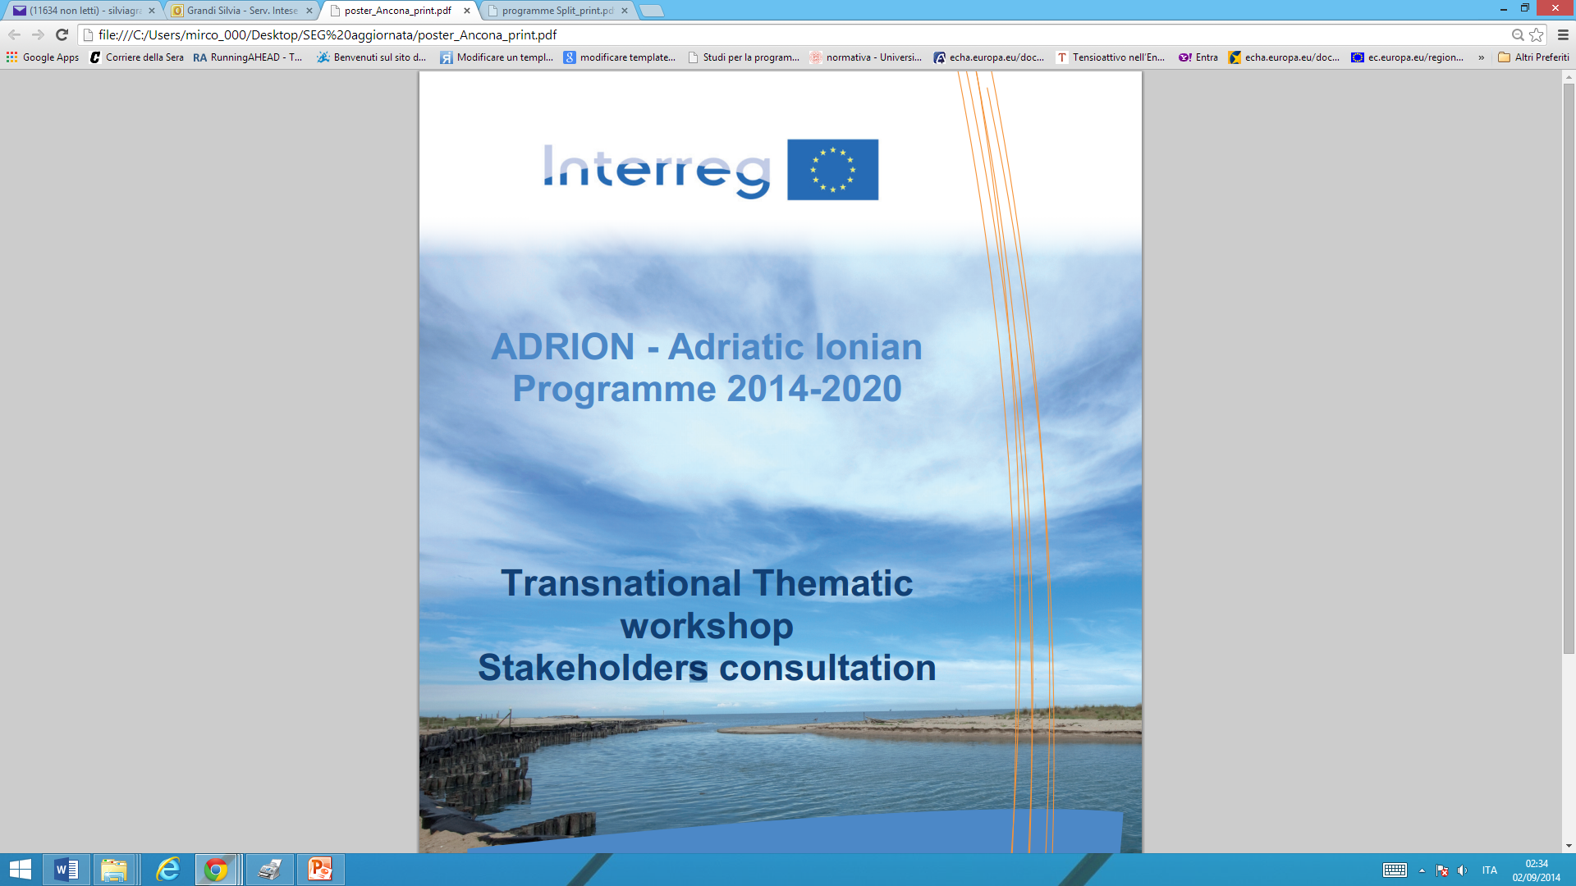
Lodovico Gherardi
Regione Emilia-Romagna
Core Start-up Team of the future Managing Authority
lgherardi@regione.emilia-romagna.it

Slide 2
2014-2020 programming period
novelties for the European South Eastern
Transnational European Territorial Cooperation
Programmes

Slide 3
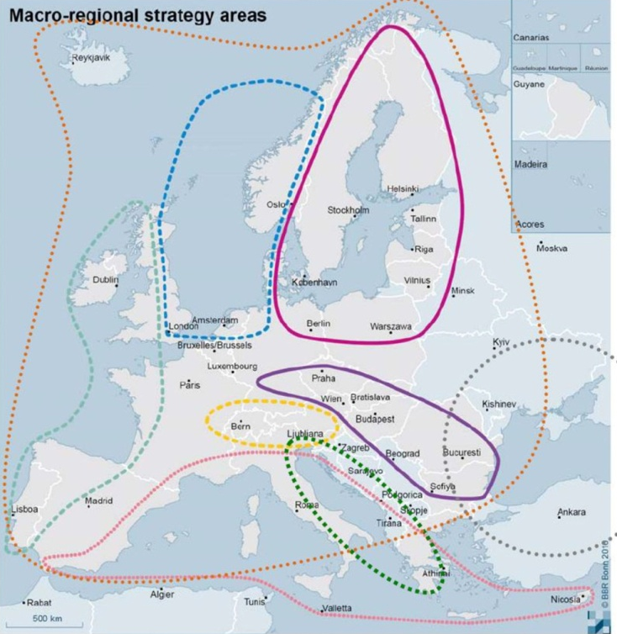
Milestones in Macroregional Strategies
2012 – European Council request to the Commission to present Action Plan for the EUSAIR (Adriatic Ionian)
2014 – Adoption of the Action Plan for the EUSAIR
  Commission → June
  Council Endorsment→ October
Source: Central Europe MA, 2013

Slide 4
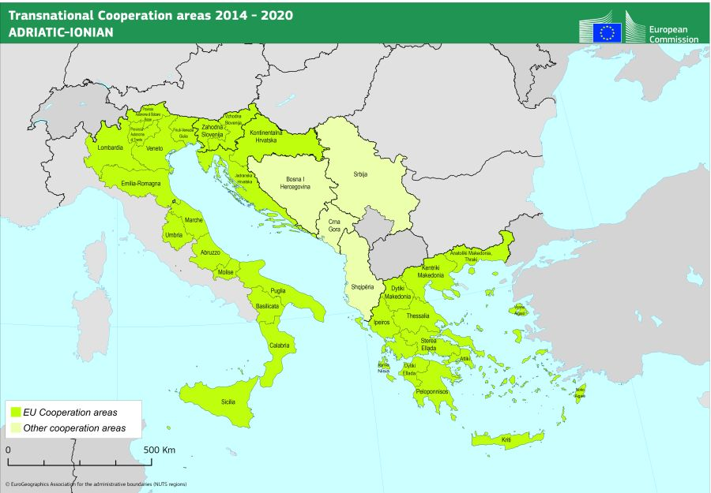
EUSAIR area
8 countries involved:
4 EU countries: Croatia,
Greece, Italy, Slovenia;
3 candidates countries:
Albania, Montenegro, Serbia;
1 potential candidate country: Bosnia and Herzegovina

Slide 5
EUSAIR macro-region characteristics
The area affects a region primarily defined by the Adriatic and Ionian Maritime Strategy, also covering important terrestrial surface area. EUSAIR treats the marine, coastal and terrestrial areas as interconnected systems

Slide 6
EUSAIR: area challenges….
Socio-economic disparities;
Transport;
Energy;
Environment;
Natural and man-made hazards and risks entailed by climate change;
Administrative and institutional issues.
… and opportunities
Blue Economy;
Connectivity;
Cultural and natural heritage and biodiversity;
Tourism.

Slide 7
EUSAIR Action Plan – Pillars and Topics
Blue Growth
Blue Technology
Fisheries and aquaculture
Connecting the region
Maritime transport
Intermodal connection to the interland
Maritime and marine governance and services
Energy networks
Environmental quality
Sustainable tourism
The marine environment
Transnational terrestrial habitats and biodiversity
Diversified tourism offer (products and services)
Sustainable and responsible tourism management (innovation and quality)
capacity-building, research and innovation, change mitigation and disaster risk management

Slide 8

EUSAIR macro-region - principles
Like the other existing macro regions (the Baltic Sea Region, the Danube Region), also EUSAIR is characterised by the “3 Nos”:
NO new funds;
NO new legislation;
NO new institutions.

Slide 9
Integrated funding approach
EARDF
ERDF
IPA II
ETC
ESF
LIFE+
Horizon
2020
COSME
EMFF
….
ENI

Slide 10
EUSAIR - funding
All Programmes operating in the area shall contribute to the implementation of the EUSAIR goals, e.g.:
Programmes directly managed by EU COM: e.g.: Life+, Creative Europe, Horizon 2020, Cosme, Erasmus +, etc.
ETC interregional, transnational and bilateral Programmes;
ERDF, ESF, EMF funds;
Contribution from other institutions (e.g. EIB, EBRD, WBIF);
National/ international public/private donors.
ADRION will contribute
to support the governance and implementation of EUSAIR, and its projects can contribute
to the governance & implementation of the Action Plan

Slide 11
11 ERDF
Thematic Objectives
Research
and Innovation
Combating
climate change
Employment &
Mobility
1
5
8
ICT
Environment and
resource efficiency
Social inclusion
2
6
9
Competitiveness
of SMEs
Sustainable
transport
Better education,
training
3
7
10
Low-carbon
economy
Better public
administration
4
11
For each TO, Investment priorities are set by the Regulations
Specific Objective defined by Programmes

Slide 12
Concentration in ETC
at least 80% of funds on max 4 thematic priorities
Priority 2
Priority 3
Priority 1
TO x
Priority 4
TO y
TO x
TO z
Cooperation Programme (CP)

Slide 13
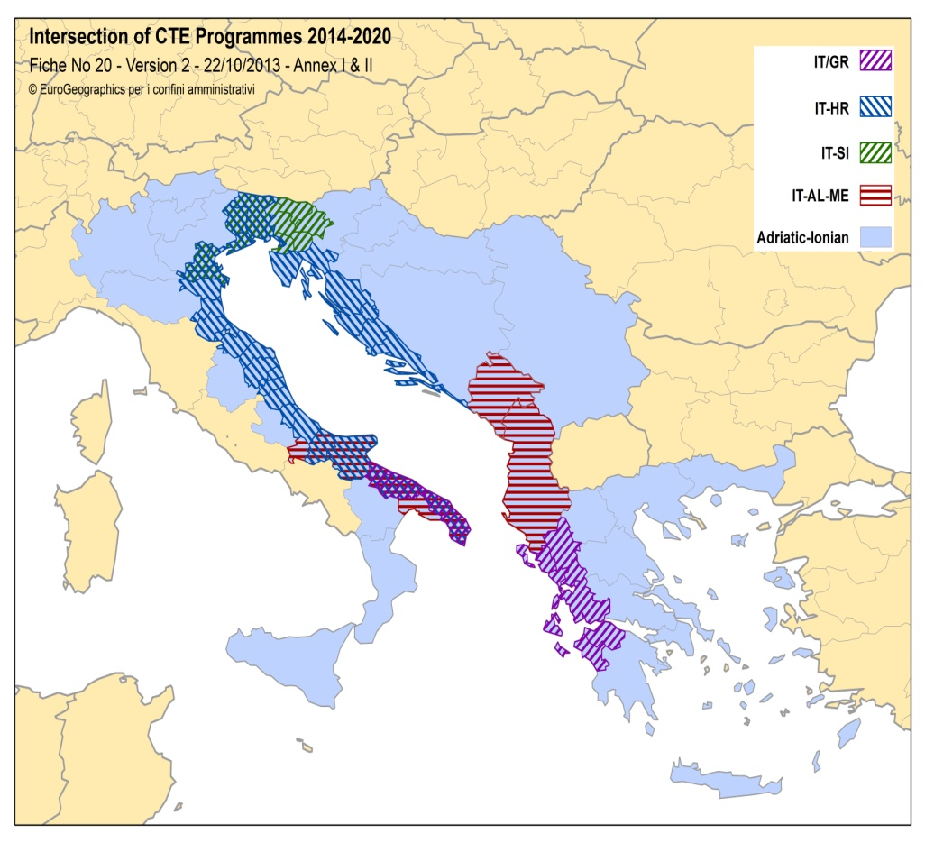
INTERREG European Territorial Cooperation 2014-2020
Crossborders
  Croatia-Slovenia
  Greece-Italy
  Italy-Croatia
  Italy-Slovenia
  IT-AL-ME (IPA II)
Transnationals
  ADRION Adriatic-Ionian
  MED
  CENTRAL EUROPE
  ALPINE SPACE
Interregionals
Interreg Europe 2020
URBACT
ESPON
INTERACT
Beyond ETC: integrate all EU, national, regional, local and private funds for common shared projects
Source: Elaboration Emilia-Romagna Region (2013) on EU shapefile

Slide 14
MAIN FEATURES OF THE PROGRAMME

Slide 15
The ADRION Programme in a nutshell
Overall goal (on-going draft CP)
To promote sustainable economic and social prosperity of the Adriatic and Ionian area through growth and jobs creation, by improving its attractiveness, competitiveness and connectivity while at the same time preserving the environment and ensuring healthy and balanced marine and coastal ecosystems

Slide 16
Area of intervention/ eligible geographical area
Adrion area coincides with EUSAIR geographical area
ELIGIBLE COUNTRIES:
Albania (entire country)
Bosnia and Herzegovina (entire country)
Croatia (entire country)
Greece (entire country)
Italy (part)
Montenegro (entire country)
Serbia (entire country)
Slovenia (entire country)

Slide 17
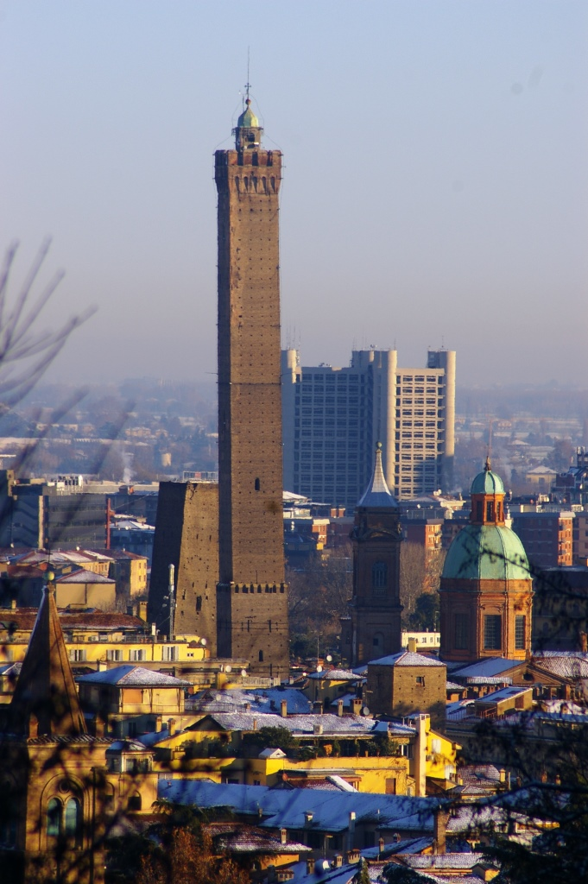
The ADRION Programme finance in a nutshell
EU available funds: 99,2 milion EUR
out of which ERDF 83,5 milion EUR
IPA II 15,7 milion EUR
        EU co-financing rate: up to 85%
        No “Common POT” (ERDF + IPA II)
        Seat of the implementing bodies:
              (Managing & Certifying Authority,
              Joint Secretariat and Audit Authority)
          Bologna – Emilia-Romagna Region

Slide 18
Thematic Objectives & Priority Axis in the Adrion Programme
Selected Thematic Objective
TO 1 - Research
TO 6 – Environment
TO 7 - Transport
TO11 – Governance
ADRION Priority Axis
Innovative and smart region
Sustainable region
Connected region
Towards a better governance of the EUSAIR

Slide 19
and Investments priorities (IP)
Priority Axis 1 –
Innovative and smart Region
  (IP 1b) - Promoting business investment in R&I
Priority Axis 2 –
Sustainable
Region
  (IP 6c) Conserving, protecting, promoting and developing natural and cultural heritage
  (IP 6d - Protecting and restoring biodiversity and soil and promoting ecosystem services, including through Natura 2000, and green infrastructure
Priority Axis 3 –
Connected
Region
  (IP 7c) Developing and improving environment-friendly transport system including multimodal links
Priority Axis 4 –
Towards a better governance of the EUSAIR
  (ETC Reg. art 7) Enhancing EUSAIR Governance
Programme priorities, TOs and IPs are in line with the overall EUSAIR goals

Slide 20
Adrion Programme Specific Objectives
Union support
M Euro
PA1:
Smart & Innovative Region
SO 1.1: Support the development of a regional Innovation system for the Adriatic-Ionian area
PA2:
Sustainable Region
SO 2.1: Promote the sustainable valorisation of natural and cultural assets as growth assets in the Adriatic-Ionian area
SO 2.2: Enhance the capacity in transnationally tacking environmental vulnerability, fragmentation and the safeguarding of ecosystem services in the Adriatic-Ionian area
PA3:
Connected region
SO 3.1: Enhance capacity for integrated transport and mobility services and multimodality in the Adriatic-Ionian area
PA4:
Towards a better governance of the EUSAIR
SO 4.1: Facilitate the coordination and implementation of the EUSAIR by enhancing institutional capacity of public administrations and key stakeholders and by assisting the progress of implementation of joint priorities.
19,8
45,6
17,8
9,9

Slide 21

Keep in touch with the programme evolution
http://www.southeast-europe.net/en/about_see/adriaticionianprogramme/index
adrionINFO@regione.emilia-romagna.it
Tel (+39) 051 52732186
Viale Aldo Moro, 30 - Bologna
Facebook
Linkedin
Twitter
…. following the future ICT evolution

